Slide 1
Programmer Development
Data Stores: Memory and Assignment

Slide 2
Structure of a C# Computer Program
using System;
namespace MyApplication
{
class MyClass1
{
static void Main(string[] args)
{
//
// TODO: Add code to start application here
//
}
}
}

Slide 3
using System
Code already written that we intend use in the program
The Namespace
Used to uniquely identify parts of the program

Slide 4
The Class
Building blocks of programs
Model real world objects
static void Main()
This is the starting point of the code to be executed

Slide 5
Using System
using System;
namespace ConsoleApplication2
{
class Program
{
static void Main()
{
Console.Write("Hello C# world");
}
}
}

Slide 6
Without using System:
namespace CsoleApp2
{
class Program2
{
static void Main()
{
System.Console.Write("Hello C# world");
}
}
}

Slide 7
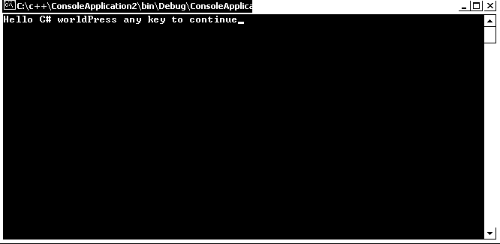
Either way the output would be:

Slide 8
What is the purpose of a computer program?
To Perform Useful Tasks
A computer program is a set of instructions to perform a task.

Slide 9
In order to perform useful tasks we need to store data:
1. We must simulate the knowledge held in memory or stored manually (Data)
2. We must simulate the knowledge needed to perform the procedures of a task (operations/algorithm)

Slide 10
Computer Program = Data + Operations
What is Data ?
How do we represent data ?
How do we store data ?

Slide 11
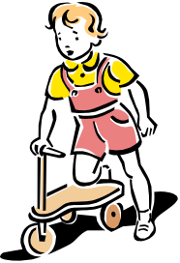


Identifiers and real world objects: Using Symbols
Identifier
Value
Used to represent
Child
Computer
Used to represent
Chair
Used to represent

Slide 12
Manual Storage of data:
Attributes used to describe objects and values
Info on a bike:
Make
Suzuki
Model
Maurauder
Year
2004
colour
Black
Information held on a table
Model
Georgian
colour
Oak
size
large

Slide 13
Possible storage values for size:
Small,medium large
Easy to read avoids confusion
S,M,L
Uses less space and each value distinguishable
5ft 4 inch
More exact measurement
232 cm
Different types of data can be stored to signify size e.g. several characters, 1 character or a number

Slide 14
Modelling Stored Data in Computer Memory
requires
requires
Identifier
Provides access
Stored value
What is an identifier ?
The attribute to be modelled
The value it will take

Slide 15

Can be represented in computer memory
symbols
Name
Has value
Used to represent
John Thomson
Identifier
Stored Value
Can be
Represented within
Computer Memory
Name
John Thomson
We must agree the identifier with the computer program.
The value must be assigned to the data store.

Slide 16
Computer Memory
consists of data stores
Need to be identified
Which can hold a value
Capital
Edinburgh

Slide 17
To hold data in Computer Memory.
We must agree the identifier with the computer program.
The value must be assigned to the data store.
We must declare the identifier within the program.

Slide 18
Data
Identifier
Stored Value
Name
Sally
Age
25
Married
No
Occupation
Nurse
Nationality
New Zealand

Slide 19
The values stored may have a different format
Numeric
Different data types
Text
Age
25
Name
Sally
We can declare the type of data that we want to store which increases efficiency.

Slide 20
Different data types for different types of stored value:
Large numbers with a decimal part
Small numbers with a decimal part.
Real numbers
Numeric
Natural numbers
Large whole numbers
Small whole numbers
A character
Text
A series of characters connected together.
True /False
Yes/no, true/false values

Slide 21
Different Values
Different Data types
Name
string
Series of characters
Age
int
Whole number value
Married
Possible to distinguish with one character
char
Occupation
string
Series of characters
Nationality
string
Series of characters
We must be able to create different types of data store for the different values

Slide 22
Declaring a data store
We can let the computer know to that we need space to hold a value.
KeyWord
int
Which will signify a data store that will hold an integer value.

Slide 23
Example Declaration:
Computer Memory
string
Name;
Results in
Name
int
Age;
char
Married;
This data store can now hold a string value but not a number.
string
Occupation;
string
Nationality;
These would become identifiers to data stores in memory that could hold values.

Slide 24
After declaration these identifiers provide access data stores that can hold values:
Simulated Computer Memory
Name
Identifier names will be used to represent and provide access to the stored values
Age
Data stores that can store the value types specified.
Married
Occupation
Nationality

Slide 25
Assigning a value to a data store
Identifier Name = Value
Examples:
In Memory :
Name
Sally
Name= “Sally”;
Age =25;
Married = ‘N’;
Occupation = “Nurse”;
Nationality = “NZ”;
Age
25
Married
N
Occupation
Nurse
Nationality
NZ

Slide 26
More Data Types and Assignment in C#

Slide 27
Numeric Data Types
Real Numbers
Natural (whole) Numbers
Float
double
byte
sbyte
short
ushort
int
uint
long
ulong
decimal

Slide 28
Declaring Identifiers of type Integer in C#
int identifier_name;
Keyword int
Tells the computer the next word is an identifier

Slide 29
int FirstNum;
Computer memory
Identifier
Stores
FirstNum
Now the variable has been declared as Firstnum we can assign values to it.

Slide 30
Assignment
FirstNum = 64;
Identifier
Stores
FirstNum
64

Slide 31
Assignment
FirstNum = 3;
Identifier
Stores
Type
FirstNum
3
The old value is replaced by the new assignment

Slide 32
Each data type sets aside a certain amount of memory
Possible representations
With 8 bits (1 byte)
Possible combinations of 1,s and 0,s
0 0 0 0 0 0 0 0
8
for 8 bits is:
2
= 256
0 0 0 0 0 0 0 1
for 9 bits is:
9
2
= 512
for 16 bits is:
16
2
0 0 0 0 0 0 1 0
for 32 bits is:
32
2
…

Slide 33
Data Type No of bits Value Range
byte 8 0…255
sbyte 8 -128 …127
short 16 -32768..32767
ushort 16 0…65535
int 32 -2,147,483,648…
2,147,484,647
uint 32 0…4,294,967,295
long 64 -9,223,372,036,854,775808…
9,223,372,036,854,775,807
ulong 64 0..18,446,744,073,709,551,615
Whole number data types and ranges

Slide 34
Creating data stores with code
short FirstNum;
uint AnotherNum;
byte AsmallNum;
long MyLongNumber;
Any legal data type name creates a data store that will hold that type of value
Identifier to the data store

Slide 35
Real Number Data Types
float
double
The float is accurate to 7 decimal digits of precision.
A more precise floating point number with 15 digits of precision.

Slide 36
Example declaration of real numbers:
double MyDouble;
float MyFloat;
Real number data stores are created in the same way
Example assignment:
MyDouble = 4.555555555555;
MyFloat = 17.5F;
Note the use of F on initialisation of the float value

Slide 37
The decimal data Type:
128 bits
Accuracy to 28 digits
Suitable for monetary values
Decimal MyPay;
MyPay = 0.0000000000000001M;
Note the use of the M on initialisation of this data type.

Slide 38
Strings
Another main data structure that you will use is the string data type.
Strings are quite simply characters strung together.

Slide 39
Strings
The size set aside in memory for a string is 1 byte per character.
Strings are enclosed in double quotes e.g.
“po098”
“12345”
“this is a string”

Slide 40
Declaring a string
string MyString;

Slide 41
Assigning a value
Example of assigning a value to mystring
MyString = “hello”;
h
e
l
l
0
Notice the double quotes to signify the beginning and end of the value of the string.

Slide 42
The char Data Type
Declaring:
char MyChar;
Example of assigning a value to mystring:
myChar = ‘C’;
MyChar
C
Note the single quotes for a char value.

Slide 43
The Boolean Data type
Can take one of two values
True
False

Slide 44
The Boolean Data type
You are either Happy or you are not!
bool Happy;
Happy = true;
or
Happy = false;

Slide 45
Operators
Program = Data + operations

Slide 46
Basic Arithmetic Operators
Operations
Operator
Addition +
Subtraction -
Multiplication *
Division /
Modulus %
To avoid problems with precedence use brackets e.g. 7*4 + 2 (7*4) + 2 or 7*(4 + 2) avoids logic errors and ambiguity.

